Slide 1
鋰離子電池組健康狀態估算方法之回顧
A review of state-of-health estimation for lithium-ion battery packs
台灣科技大學 AI所
指導教授： | 羅一峰 博士
學生： | 林志龍
Journal of Energy Storage 118 (2025) 116078

Slide 2
Outline
Introduction
Degradation Mechanisms
Health Feature Extraction
SOH Estimation Models
Comparison of Models
Challenges & Future Prospects
Conclusion

Slide 3
Introduction
Limited Scope: Most existing reviews focus solely on single-cell estimation.
Why SOH Matters:
SOH is the cornerstone of safety and reliability for Electric Vehicles (EVs) and Energy Storage Systems.
Why Focus on "Battery Packs” ?
Real-world Application: EVs operate on battery packs (series/parallel), not isolated cells
The "Barrel Effect": Pack performance is limited by the weakest cell. Inconsistency between cells accelerates degradation faster than single-cell aging .
The Research Gap:
Limited Scope: Most existing reviews focus solely on single-cell estimation.
The Missing Link: There is a scarcity of comprehensive reviews addressing pack-level SOH estimation and the impact of cell inconsistency.

Slide 4
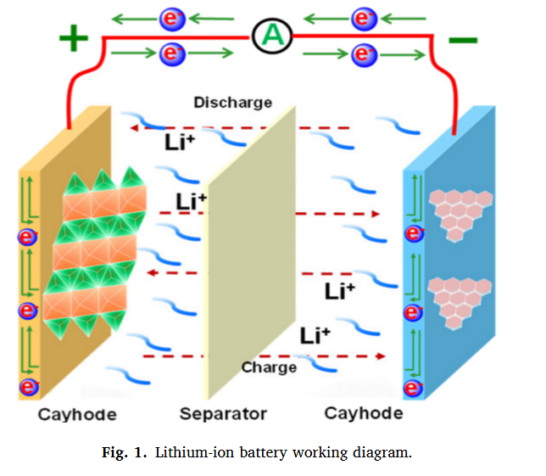
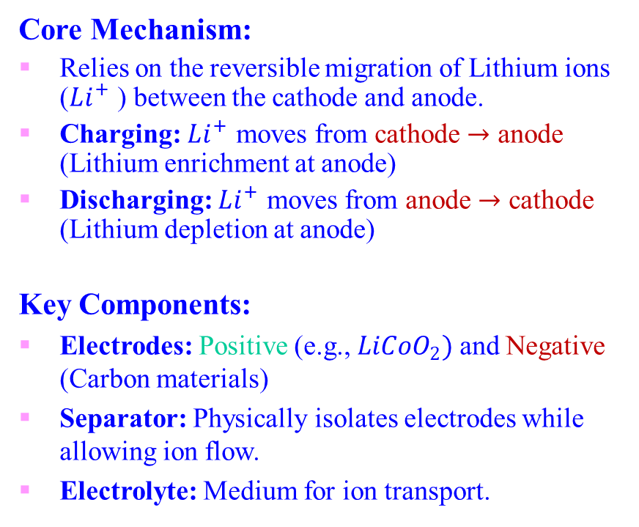
Degradation Mechanisms
How Lithium-ion Batteries Work
Core Mechanism:
Relies on the reversible migration of Lithium ions ($Li^{+}$ ) between the cathode and anode.
Charging: $Li^{+}$ moves from cathode $→$ anode (Lithium enrichment at anode)
Discharging: $Li^{+}$ moves from anode $→$ cathode (Lithium depletion at anode)
Key Components:
Electrodes: Positive (e.g., $LiCoO_{2})$and Negative (Carbon materials)
Separator: Physically isolates electrodes while allowing ion flow.
Electrolyte: Medium for ion transport.
Notes:
實驗平台由 Arbin 的 LBT 系列 電池充放電測試儀、高低溫試驗箱，以及一台主控電腦組成

Slide 5
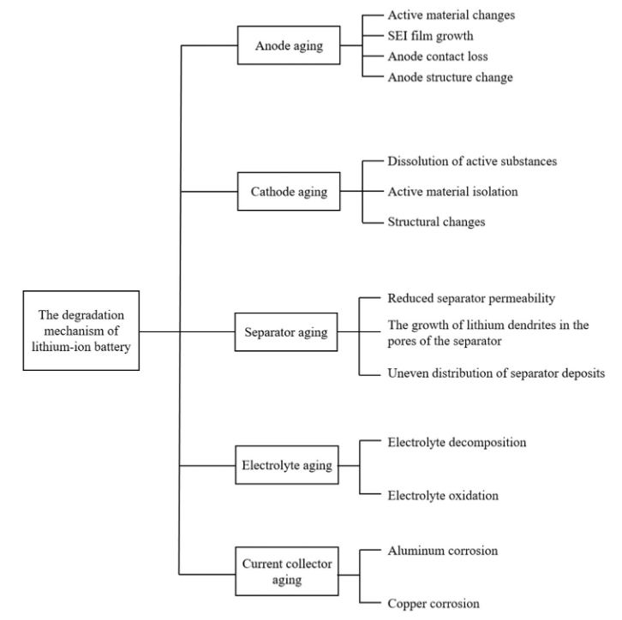
Degradation Mechanisms
Cell-Level Degradation Mechanisms
Chemical Degradation:
SEI Growth: Continuous formation of Solid Electrolyte Interphase consumes active lithium and increases internal resistance.
Electrolyte Decomposition: Reduction/oxidation reactions alter electrolyte composition.
Active Material Loss: Dissolution of electrode structures reduces reversible capacity.
Mechanical Degradation:
Volume Changes: Stress from particle expansion/contraction during cycling leads to structural damage.
Fig. 2
Notes:
實驗平台由 Arbin 的 LBT 系列 電池充放電測試儀、高低溫試驗箱，以及一台主控電腦組成

Slide 6
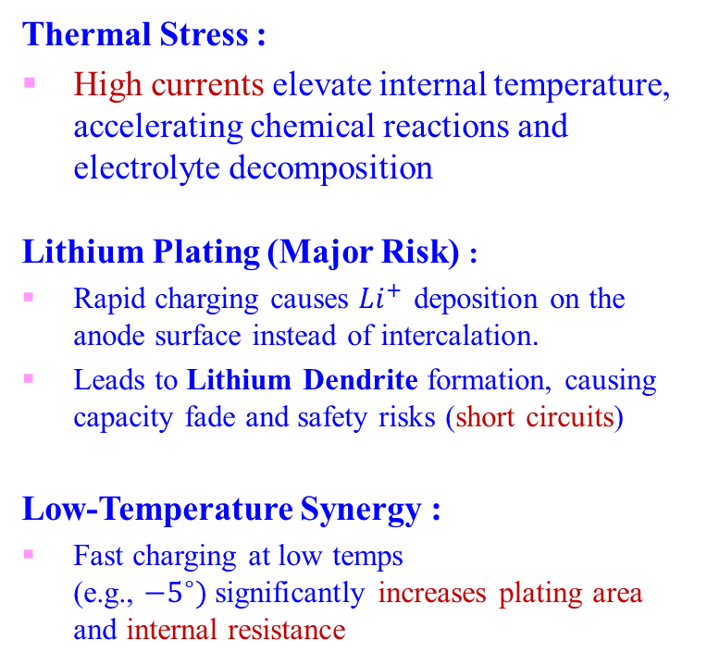
Degradation Mechanisms
Impact of Fast Charging on Battery Health
Thermal Stress :
High currents elevate internal temperature, accelerating chemical reactions and electrolyte decomposition
Lithium Plating (Major Risk) :
Rapid charging causes $Li^{+}$ deposition on the anode surface instead of intercalation.
Leads to Lithium Dendrite formation, causing capacity fade and safety risks (short circuits)
Low-Temperature Synergy :
Fast charging at low temps (e.g., $−5^{∘})$significantly increases plating area and internal resistance
Fig. 2
Notes:
實驗平台由 Arbin 的 LBT 系列 電池充放電測試儀、高低溫試驗箱，以及一台主控電腦組成

Slide 7
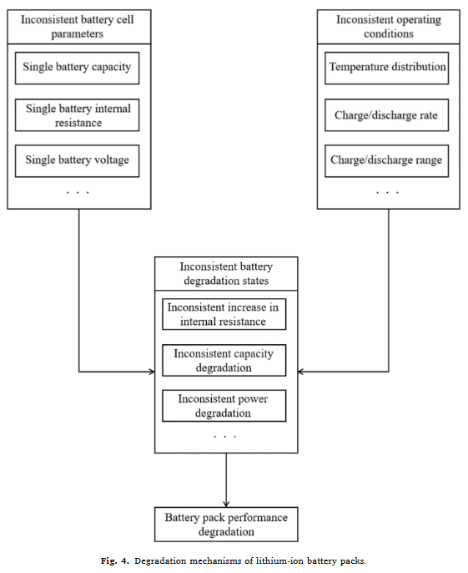
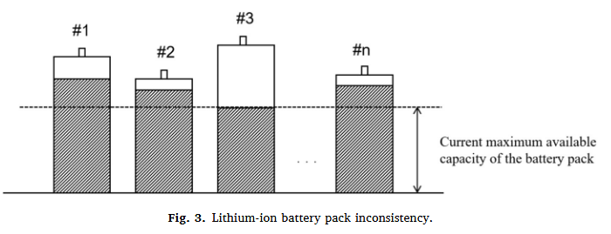
Degradation Mechanisms
Degradation Mechanism of Battery Packs
The "Barrel Effect :
In series connections, the weakest cell determines the entire pack's usable capacity and performance
The "Vicious Cycle" of Inconsistency:
Initial State: Minor manufacturing differences lead to uneven heat and current distribution.
Operation: Variations in internal resistance cause uneven aging rates across cells
Result: Inconsistency expands over time, accelerating overall pack failure
Notes:
實驗平台由 Arbin 的 LBT 系列 電池充放電測試儀、高低溫試驗箱，以及一台主控電腦組成

Slide 8
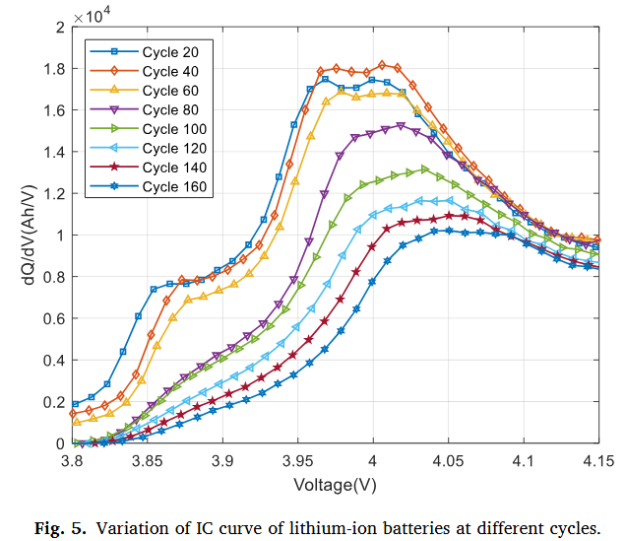
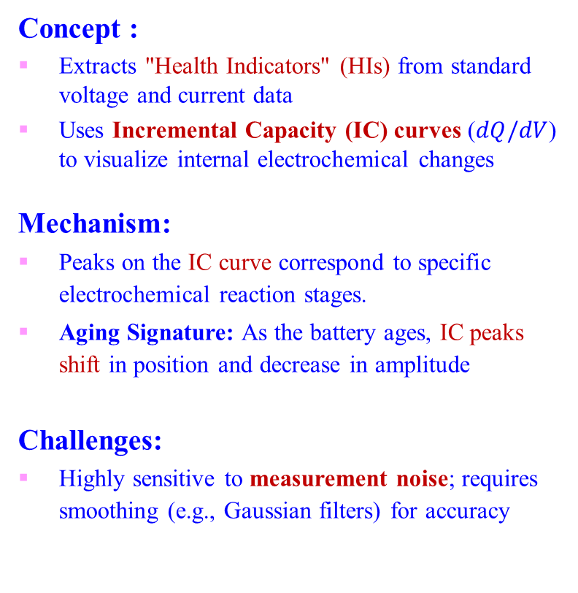
Health Feature Extraction
Extracting Features from Charging Curves
Concept :
Extracts "Health Indicators" (HIs) from standard voltage and current data
Uses Incremental Capacity (IC) curves ($dQ/dV$) to visualize internal electrochemical changes
Mechanism:
Peaks on the IC curve correspond to specific electrochemical reaction stages.
Aging Signature: As the battery ages, IC peaks shift in position and decrease in amplitude
Challenges:
Highly sensitive to measurement noise; requires smoothing (e.g., Gaussian filters) for accuracy
Notes:
實驗平台由 Arbin 的 LBT 系列 電池充放電測試儀、高低溫試驗箱，以及一台主控電腦組成

Slide 9
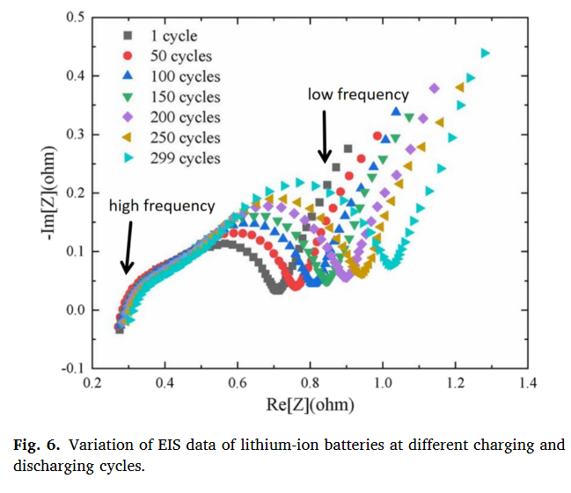
Health Feature Extraction
Time-Domain & Frequency-Domain Features
Time-Based Features (Simple & Fast) :
Monitors the duration of charging phases.
Trend: In CC-CV charging, the Constant Voltage (CV) time increases while Constant Current (CC) time decreases with aging
Pros: Low computational cost Cons: Requires strict charging protocols
Frequency-Domain (EIS) (Deep Analysis):
Uses Electrochemical Impedance Spectroscopy (EIS) to measure internal resistance and SEI film growth
Pros: Provides deep insight into internal kinetics Cons: Equipment is expensive and time-consuming
Notes:
實驗平台由 Arbin 的 LBT 系列 電池充放電測試儀、高低溫試驗箱，以及一台主控電腦組成

Slide 10
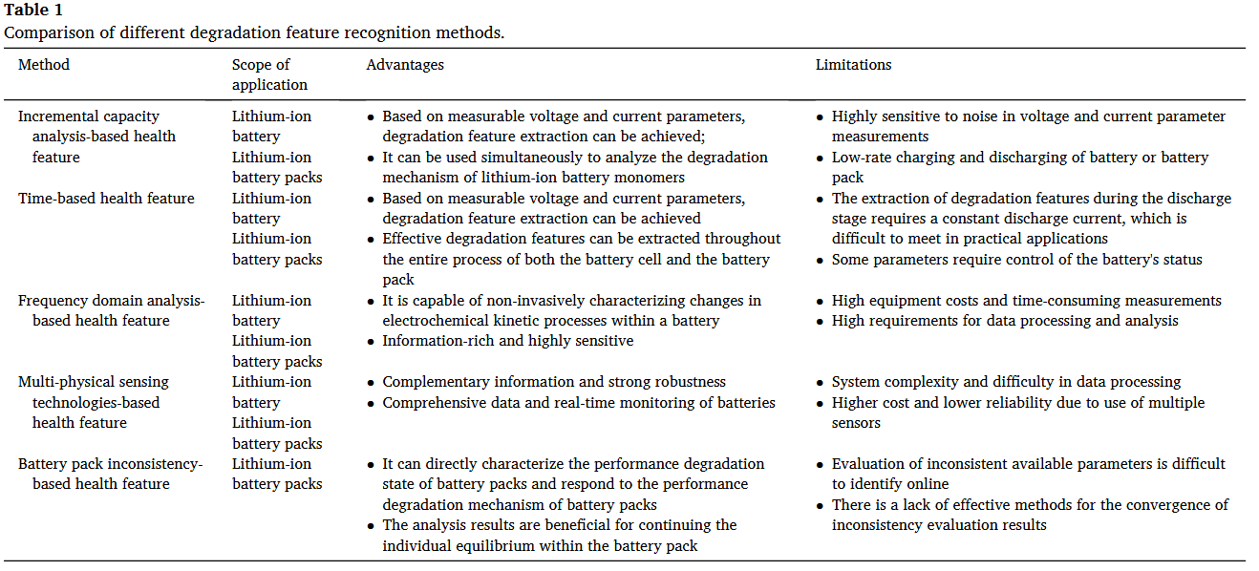
Health Feature Extraction
Pack-Level Features & Comparison
Notes:
實驗平台由 Arbin 的 LBT 系列 電池充放電測試儀、高低溫試驗箱，以及一台主控電腦組成

Slide 11
SOH Estimation Models
Model-Based Approaches (The "White Box")
Core Concept:
Estimates internal states (SOC/SOH) by observing external measurements (Voltage, Current, Temp).
Uses State-Space Models to mathematically represent battery physics.
Key Algorithms :
Kalman Filter (KF): Recursive algorithm suitable for linear systems. Fast and low complexity .
Extended Kalman Filter (EKF): Modified version to handle non-linear battery behaviors.
Particle Filter (PF): Uses Monte Carlo sampling; excellent for non-Gaussian noise and highly non-linear systems.
Pros & Cons:
Pro: Real-time capability, low computational cost.
Con: Heavily relies on the accuracy of the initial battery model.
Notes:
實驗平台由 Arbin 的 LBT 系列 電池充放電測試儀、高低溫試驗箱，以及一台主控電腦組成

Slide 12
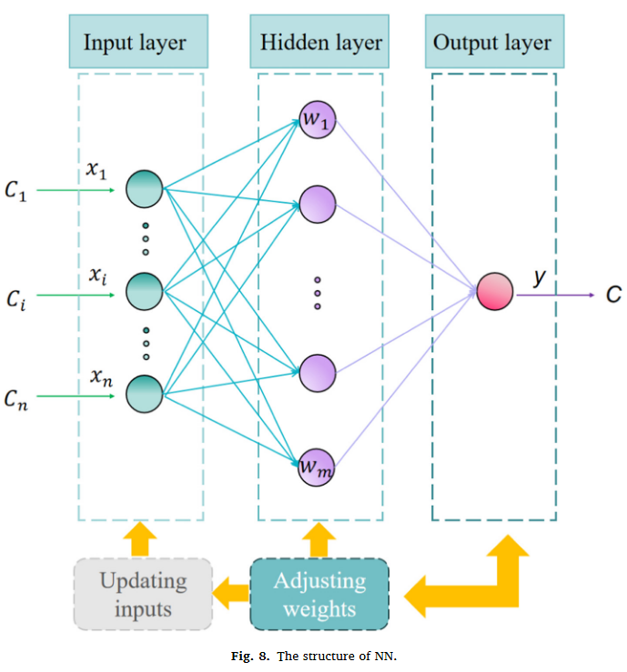
SOH Estimation Models
Data-Driven Approaches (The "Black Box")
Core Concept :
Treats the battery as a "Black Box". No need to understand complex internal chemical reactions .
Learns mapping rules between "Health Features" and SOH directly from historical data.
Architectures:
SVM (Support Vector Machine): Identifies an optimal hyperplane to separate data; highly effective for small datasets .
RVM (Relevance Vector Machine): A Bayesian sparse model that improves on SVM by providing probabilistic predictions (uncertainty) .
GPR (Gaussian Process Regression): A non-parametric model that uniquely outputs confidence intervals (reliability) alongside the prediction .
NN (Neural Network): Mimics human neurons to excel at processing complex, non-linear data without detailed physical knowledge .
ELM (Extreme Learning Machine): Uses random weights for single-layer networks, achieving superior training speed compared to traditional NNs .
Notes:
實驗平台由 Arbin 的 LBT 系列 電池充放電測試儀、高低溫試驗箱，以及一台主控電腦組成

Slide 13
SOH Estimation Models
Hybrid Methods
Hybrid SOH Estimation:
Combines Model-based + Data-driven methods (e.g., Kalman Filter + Neural Network).
Why Hybrid? It leverages the strengths of both worlds to improve accuracy and generalization.
Comparison Summary:
Filters: Good for real-time, but model-dependent.
Machine Learning: High accuracy, but requires massive training data ("Data Hungry").
Hybrid: Highest accuracy and robustness, but computationally expensive (Complex).
Notes:
實驗平台由 Arbin 的 LBT 系列 電池充放電測試儀、高低溫試驗箱，以及一台主控電腦組成

Slide 14
Comparison of Models
Strength: Low computational complexity; excellent for real-time BMS updates.
Speed vs. Accuracy vs. Complexity
Statistical Filters (The "Fast" Option):
Strength: Low computational complexity; excellent for real-time BMS updates.
Weakness: Highly sensitive to measurement noise; struggles with non-linear systems.
Machine Learning (The "Precise" Option):
Strength: High accuracy; strong generalization; effectively handles non-linear data.
Weakness: "Data hungry" (needs large datasets); computationally expensive; lacks interpretability (Black Box).
Hybrid Methods (The "Balanced" Option):
Strength: Combines the best of both worlds, high accuracy with strong robustness.
Weakness: Most complex to implement; requires significant processing power.
Notes:
實驗平台由 Arbin 的 LBT 系列 電池充放電測試儀、高低溫試驗箱，以及一台主控電腦組成

Slide 15
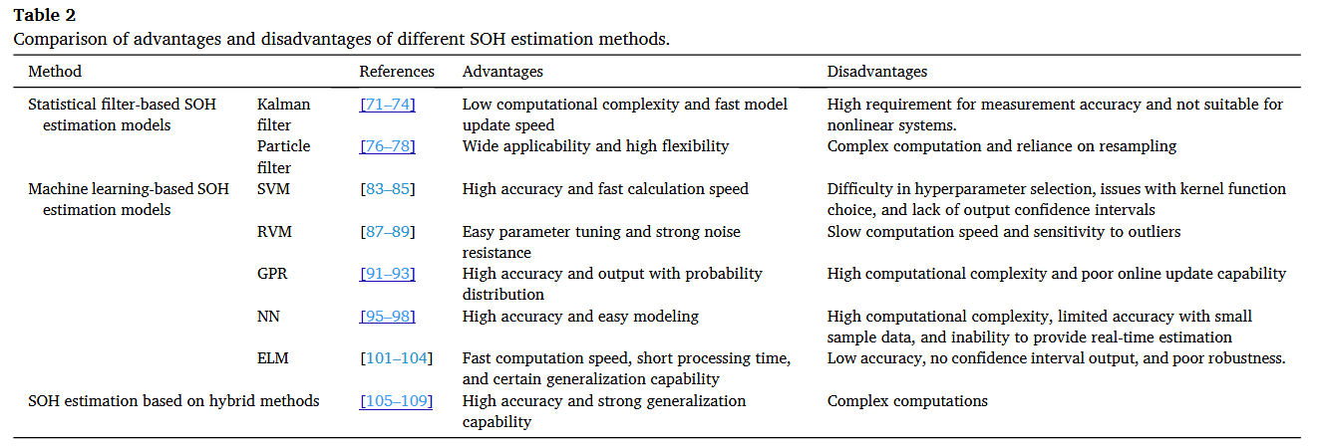
Comparison of Models
Speed vs. Accuracy vs. Complexity
Notes:
實驗平台由 Arbin 的 LBT 系列 電池充放電測試儀、高低溫試驗箱，以及一台主控電腦組成

Slide 16
Comparison of Models
Strength: Low computational complexity; excellent for real-time BMS updates.
Estimation Error Comparison
(Based on Reviewed Papers)
Filter-based Performance:
Error: RMSE ~1.2% - 3.37%.
Note: Good for general use but precision varies with model quality.
Machine Learning Performance:
SVM/RVM: High precision, often achieving RMSE < 0.5% (e.g., 0.357% in studies).
Neural Networks: Robust performance, typically RMSE ~1.0% - 2.0%.
Hybrid Methods Performance:
Superior Accuracy: Often achieves the lowest error rates.
Reported MAE as low as 0.014 and RMSE ~0.032 in advanced implementations.
Notes:
實驗平台由 Arbin 的 LBT 系列 電池充放電測試儀、高低溫試驗箱，以及一台主控電腦組成

Slide 17
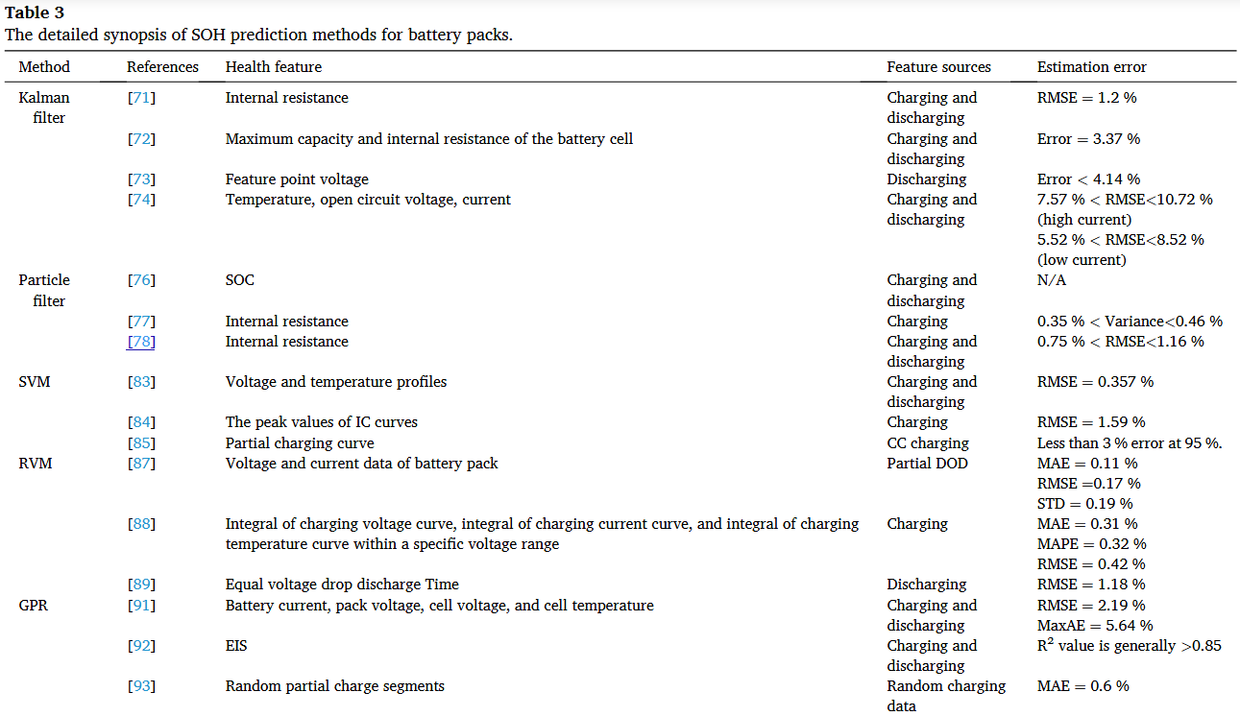
Comparison of Models
Strength: Low computational complexity; excellent for real-time BMS updates.
Estimation Error Comparison
(Based on Reviewed Papers)
Notes:
實驗平台由 Arbin 的 LBT 系列 電池充放電測試儀、高低溫試驗箱，以及一台主控電腦組成

Slide 18
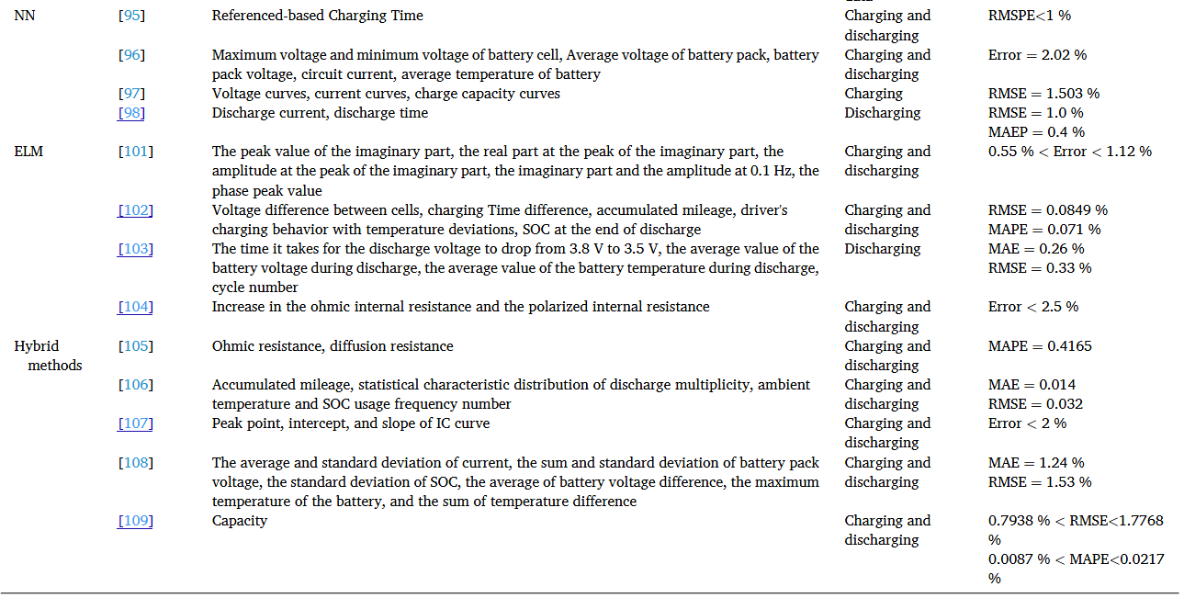
Comparison of Models
Strength: Low computational complexity; excellent for real-time BMS updates.
Estimation Error Comparison
(Based on Reviewed Papers)
Notes:
實驗平台由 Arbin 的 LBT 系列 電池充放電測試儀、高低溫試驗箱，以及一台主控電腦組成

Slide 19
Challenges & Future Prospects
Strength: Low computational complexity; excellent for real-time BMS updates.
Barriers to Real-World Implementation
The Measurement Problem:
Accurate internal parameters (e.g., impedance) are difficult to isolate due to coupled electrochemical reactions and sensor limitations
The "Lab-to-Reality" Gap:
Training Data: Models are often trained on clean laboratory data.
Real World: Practical operation involves noisy data, sensor errors, and poor data quality, significantly reducing model accuracy .
Environmental Adaptability:
Current methods struggle with dynamic conditions (fluctuating temperatures, varying discharge rates) common in EV driving, as opposed to stable lab environments .
Notes:
實驗平台由 Arbin 的 LBT 系列 電池充放電測試儀、高低溫試驗箱，以及一台主控電腦組成

Slide 20
Challenges & Future Prospects
Strength: Low computational complexity; excellent for real-time BMS updates.
The Road Ahead for SOH Technology
Adapting to New Tech:
Developing models for Solid-State Batteries (the future of EVs), which have different electrolytes and safety profiles compared to current Li-ion batteries .
Advanced Sensing Technologies:
Moving beyond Voltage/Current: Integrating Ultrasonic, Laser, and Infrared Thermography to "see" inside the battery without destroying it .
Smarter BMS Integration:
Goal: Embed Hybrid Models directly into the Battery Management System (BMS).
Benefit: Enables real-time, adaptive management strategies like optimized charging protocols to extend battery life .
Notes:
實驗平台由 Arbin 的 LBT 系列 電池充放電測試儀、高低溫試驗箱，以及一台主控電腦組成

Slide 21
Conclusion
Strength: Low computational complexity; excellent for real-time BMS updates.
The Core Problem: Pack Inconsistency
SOH estimation has shifted focus from single cells to Battery Packs.
Key Finding: Cell inconsistency (the "Barrel Effect") is the primary driver of accelerated pack degradation, requiring specialized "Pack-Level" features..
The Best Methodology: Hybrid Models
While Statistical Filters offer speed and Machine Learning offers precision, Hybrid Methods represent the optimal solution.
They balance computational cost with high accuracy, minimizing errors better than single approaches.
The Goal: From Lab to BMS
Current research succeeds in controlled environments but faces a "Reality Gap" (noise/temp).
Future Direction: Integrating robust Hybrid models into real-time BMS to ensure safety and reliability in actual EV operations .
Notes:
實驗平台由 Arbin 的 LBT 系列 電池充放電測試儀、高低溫試驗箱，以及一台主控電腦組成

Slide 22
Journal of Energy Storage 118 (2025) 116078
Strength: Low computational complexity; excellent for real-time BMS updates.
Thank you
Notes:
實驗平台由 Arbin 的 LBT 系列 電池充放電測試儀、高低溫試驗箱，以及一台主控電腦組成

